Slide 1
Introduction to Haematology
Dr.Ihsan Mardan Humod
MBCHB,MSc,FIBMS (Haematopathologist)

Slide 2
BIOHAZARD PRECAUTIONS
Laboratory policies must be in place to ensure that staff who collect blood samples and transfer them to the laboratory minimise the risk of infection from various pathogens during all aspects of specimen handling.
Additional precautions should be taken when handling high-risk specimens (e.g. those from patients suspected of having a viral haemorrhagic fever). In this circumstance, the collection policy should stipulate the use of personal protective equipment, such as disposable gloves, body apron and protective eyewear.
Care must be taken to prevent injuries, especially when handling and disposing of needles and lancets.

Slide 3
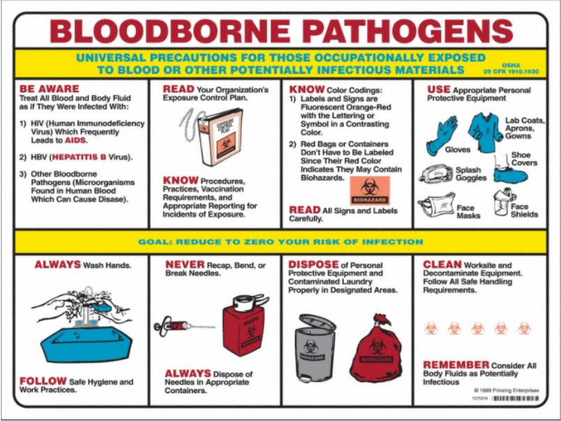

Slide 4
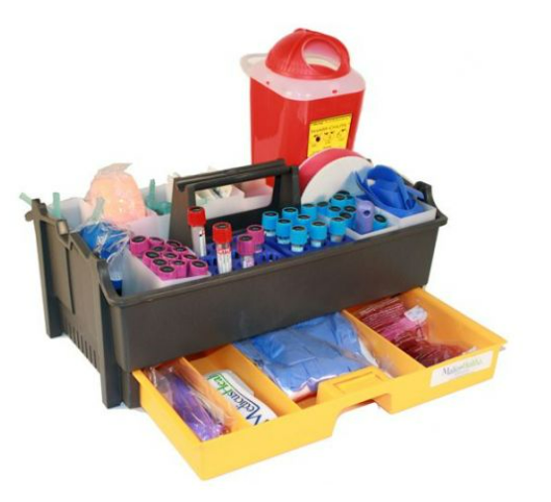

Slide 5
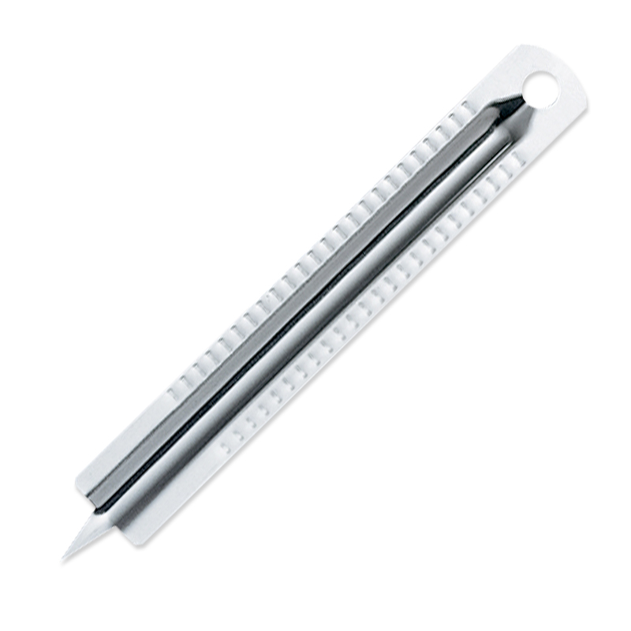
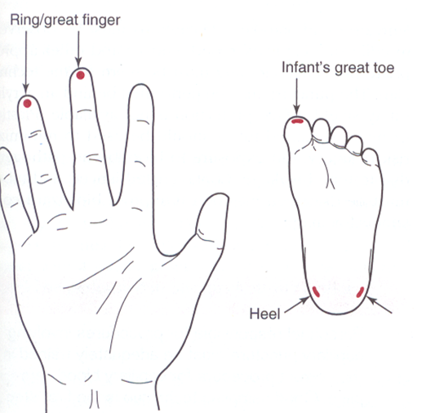
CAPILLARY BLOOD
Collection of capillary blood
Skin puncture is carried out with a needle or lancet.
In adults and older children, blood can be obtained from a finger (distal digit of the third or fourth finger on its palmar surface)
In infants, a deep puncture of the plantar surface of the heel.

Slide 6
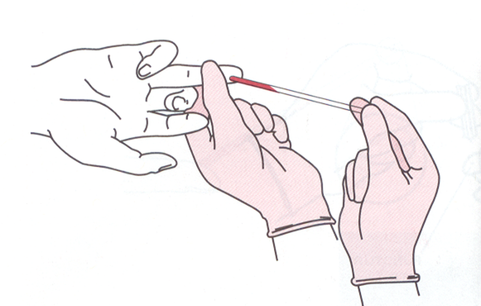
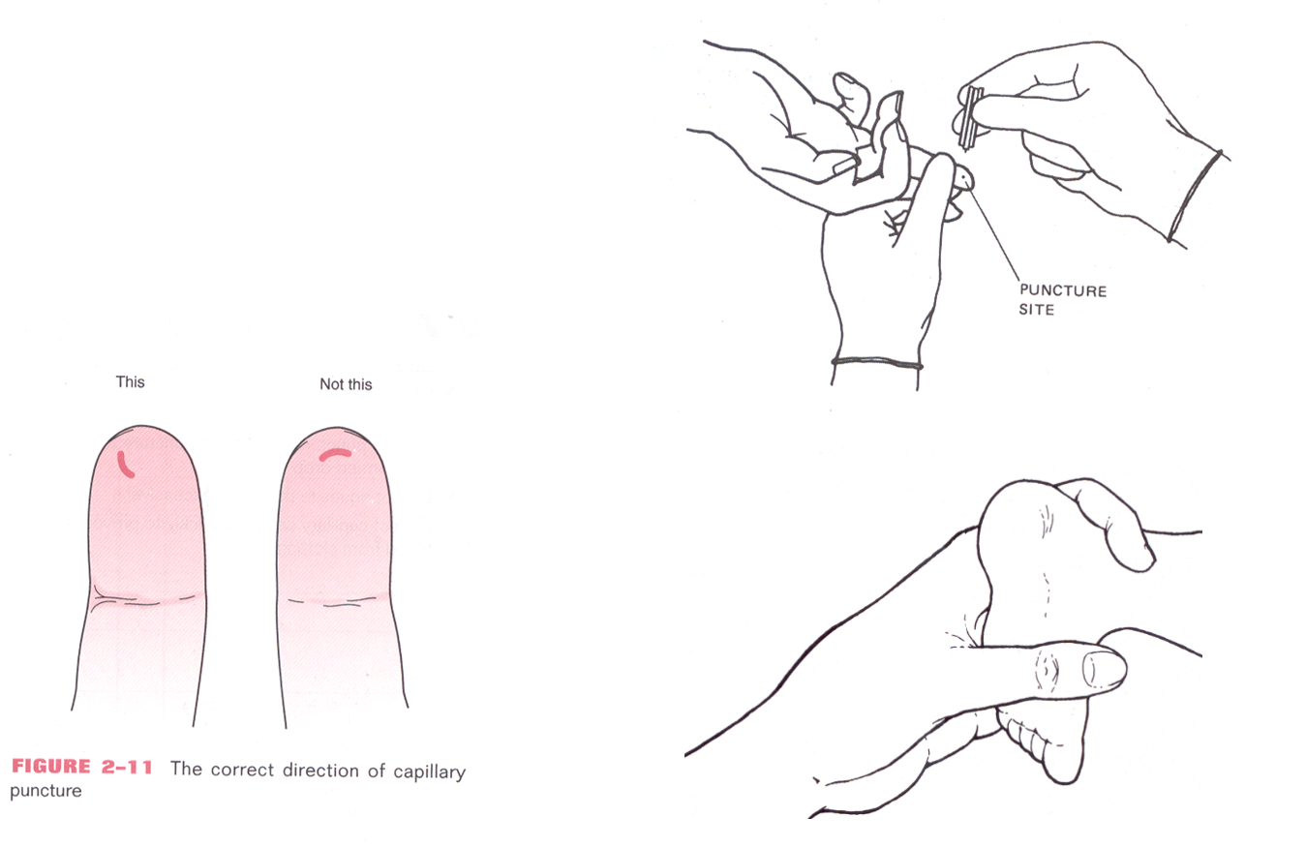

Slide 9
PROCUREMENT OF VENOUS BLOOD
Equipment
Needle diameter is a compromise between achieving adequate flow with minimal turbulence and minimising patient discomfort. A 19-gauge (19G) or 21G needle is suitable for most adults. A 23G needle is often selected for children. The shaft of the needle should be short (about 15 mm).
Winged needle (often referred to as a ‘butterfly’)

Slide 11
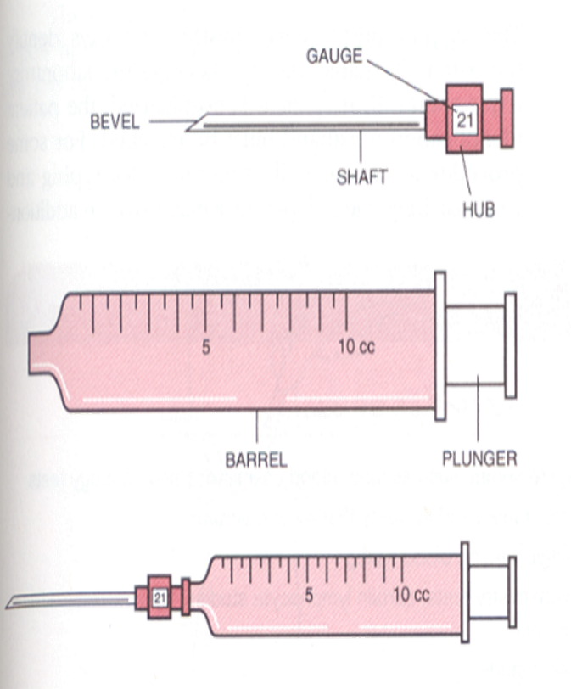
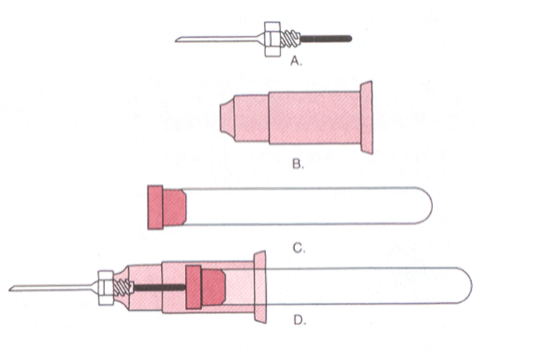

Slide 13
Specimen containers
Containers for testing whole blood are available commercially with dipotassium, tripotassium or disodium ethylenediaminetetra-acetic acid (EDTA) anticoagulant, and often have a mark to indicate the correct amount of blood to be added. Containers are also available containing trisodium citrate, heparin or acid–citrate–dextrose, as well as containers with no additive which are used when serum is required.
Evacuated tube systems in common use consist of a glass or plastic tube under a defined vacuum, a needle and a needle holder, which secures the needle to the tube.

Slide 14
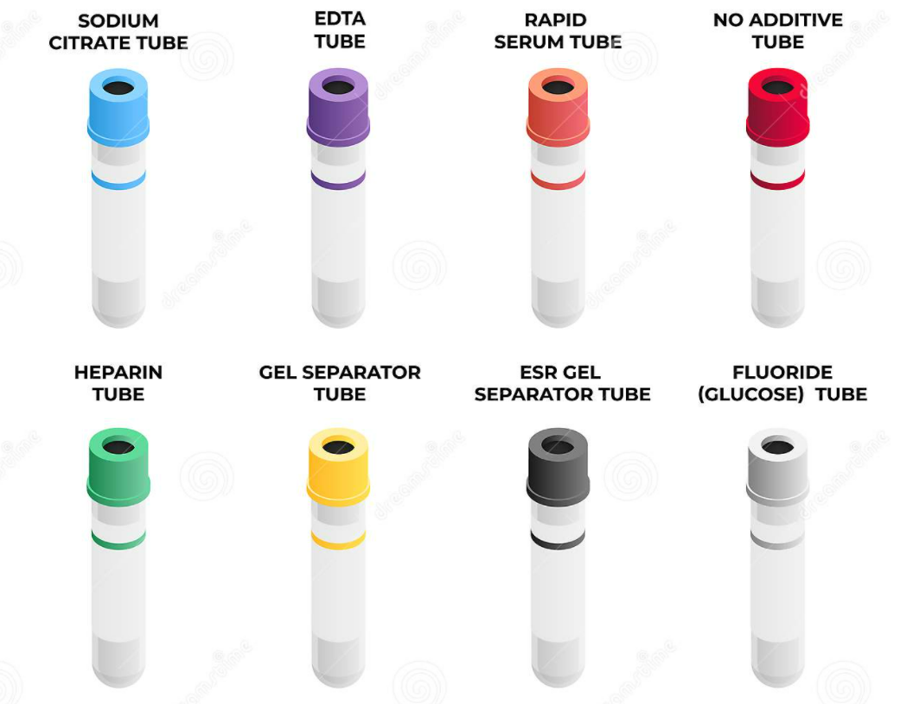

Slide 16
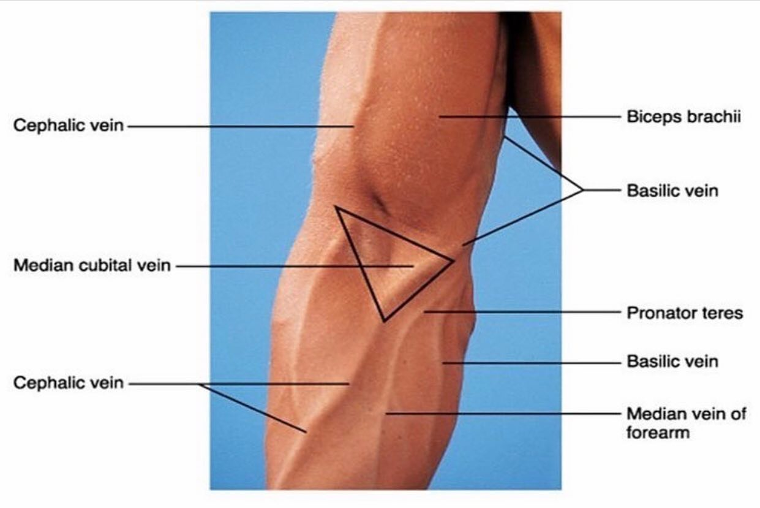
Phlebotomy procedure

Slide 17
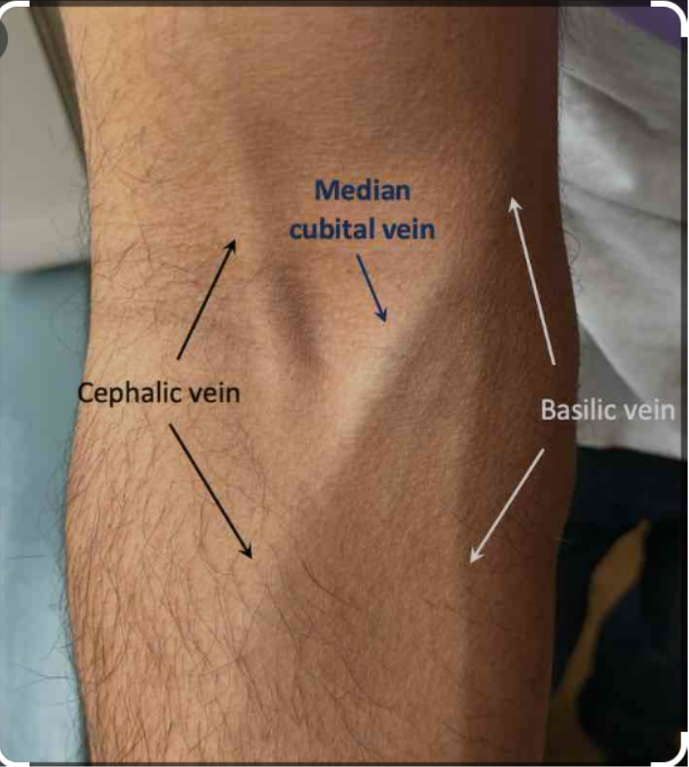
Phlebotomy procedure
The phlebotomist should be adequately trained.
A tourniquet should be applied just above the intended venepuncture site (antecubital vein).
It is recommended that the skin be cleaned with 70% alcohol (e.g., isopropanol) and allowed to dry spontaneously before being punctured.
The tourniquet should be released as soon as the vein is punctured (haemoconcentration)
After the vein has been successfully punctured, the piston of the syringe should be withdrawn slowly with no attempt being made to withdraw blood faster than the vein is filling.
Anticoagulated specimens must be mixed by inverting the container several times.

Slide 18
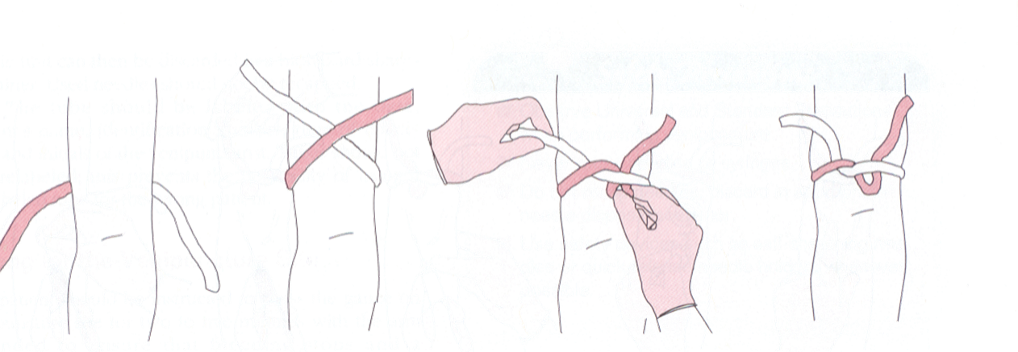
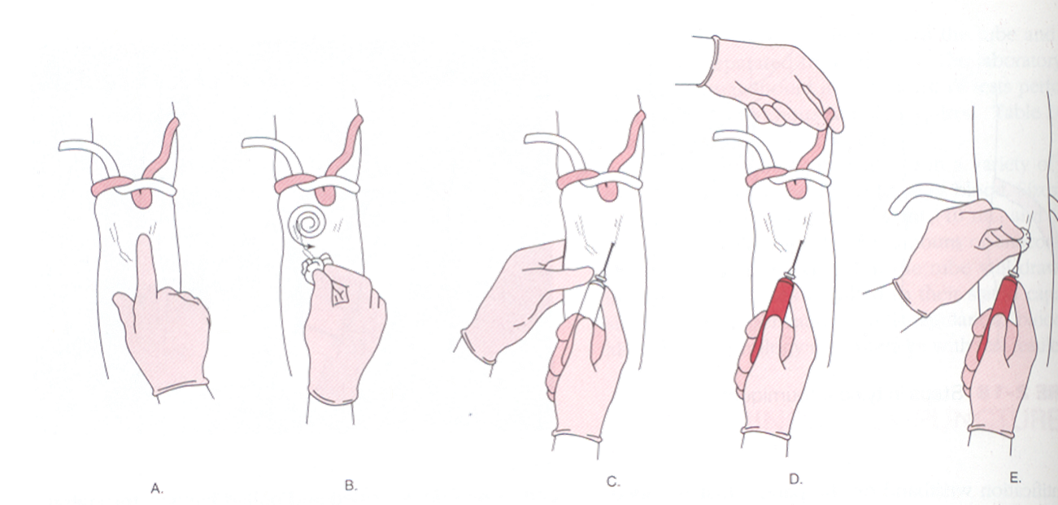

Slide 19
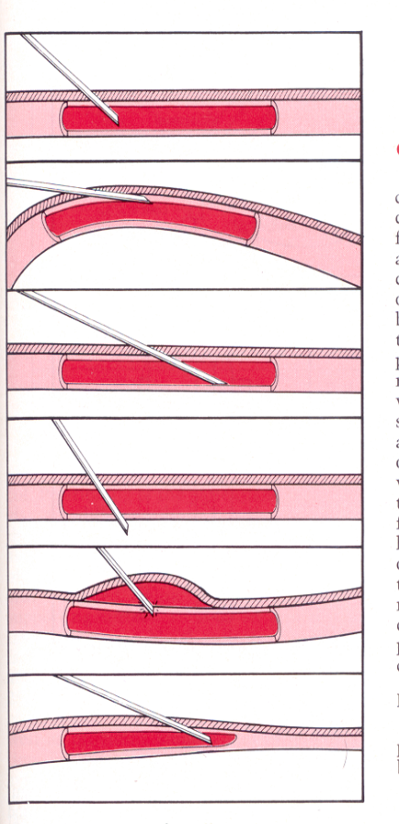
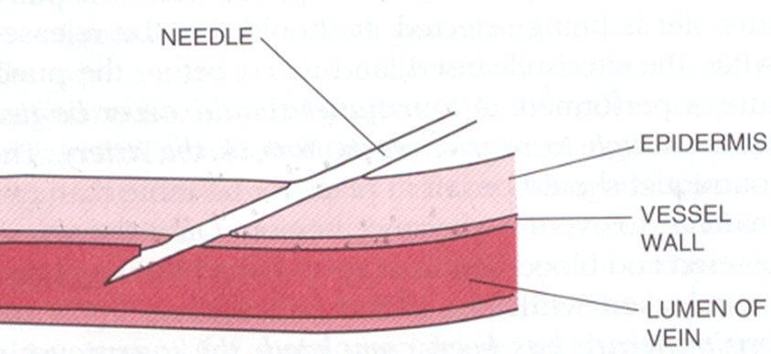

Slide 20
The risk of unwanted haemolysis of the specimen can be minimized by
  using minimal tourniquet time,
  withdrawing blood carefully,
  using an appropriately sized needle,
  delivering the blood slowly into the receptacle
  avoiding unnecessary agitation when mixing with the anticoagulant.

Slide 21
If blood collection fails, it is important to remain calm, communicate with the patient and consider the possible causes. These include poor technique (e.g., passing the needle through the vein, or poor selection of veins), scarring of tissues and haematoma formation.
After obtaining the necessary specimens, remove the needle and press a sterile swab over the puncture site.
If intravenous fluids are being transfused into an arm, blood should generally not be collected from that arm; however, if this is essential, the specimen should be obtained from below the intravenous infusion with the tourniquet being placed below the site of infusion.

Slide 22
DIFFERENCES BETWEEN CAPILLARY AND VENOUS
BLOOD
Blood from a skin puncture is a mixture of blood from arterioles, veins and capillaries and it contains some interstitial and intracellular fluid.
The packed cell volume/haematocrit (PCV/Hct), red blood cell count (RBC) and haemoglobin concentration (Hb) of capillary blood may be slightly higher than those of venous blood. The total leucocyte and neutrophil counts may also be higher. Conversely, the platelet count appears to be higher in venous than in capillary blood; this may be due to adhesion of platelets to the site of the skin puncture.
All of these differences are minimised when a free flow of blood has been obtained after skin puncture.

Slide 23
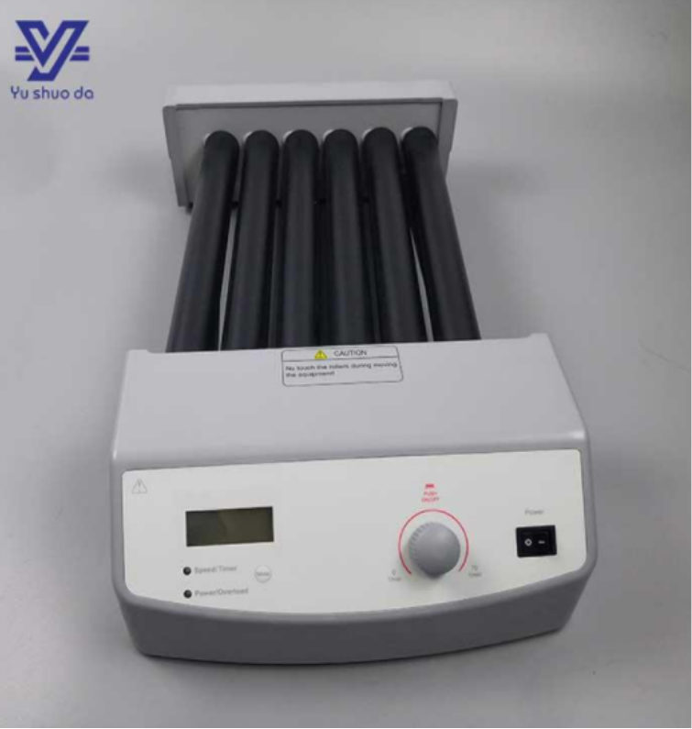
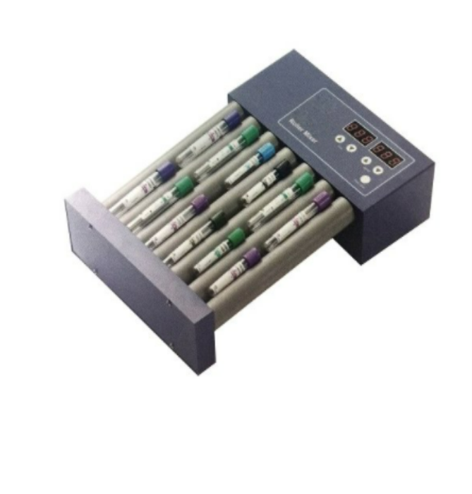
The specimen tube can be placed on a mechanical rotating mixer for 2 min or the tube can be inverted 8–10 times by hand.

Slide 24
The difference between plasma and serum is that the latter lacks fibrinogen and some coagulation factors.

Slide 26
The tubes, whether with or without a serum separator, are then centrifuged for 5 minutes at 3000 revolutions per minute (rpm).
For most tests, serum should be kept at 4 °C until used, but if testing is delayed, serum can be stored at −20 °C for up to 3 months and at −40 °C or below for long-term storage.
If the specimen has been stored at 4 °C, it will be viscous and the blood should be allowed to warm to room temperature before being mixed.
Frozen specimens should be thawed in a water bath or in a 37 °C incubator, and then inverted several times to ensure homogeneity before being used for a test.

Slide 27
ANTICOAGULANTS
EDTA (Ethylenediaminetetra-acetic acid)
Sodium citrate
Heparin
EDTA and sodium citrate remove calcium, which is essential for coagulation. Heparin binds to antithrombin, thus inhibiting the interaction of several clotting factors.

Slide 28
EDTA used for blood counts
Excess EDTA (EDTA affects both red cells and leucocytes, causing shrinkage and degenerative changes. Significant decrease in PCV and an increase in mean cell haemoglobin concentration (MCHC).
Platelets (swell and then disintegrate, an artificially high platelet count)
EDTA is responsible for the activity of a naturally occurring antiplatelet autoantibody, which sometimes causes platelet aggregation of platelet adherence to neutrophils in blood films. (All patients with apparent thrombocytopenia therefore require a blood film to identify this in vitro phenomenon).

Slide 29
Sodium citrate is used for coagulation testing and for the erythrocyte sedimentation rate. (For better long-term preservation of red cells for certain tests and for transfusion purposes, citrate is used in combination with dextrose in the form of acid–citrate–dextrose (ACD) or citrate–phosphate–dextrose (CPD)).
For coagulation studies, 9 volumes of blood are added to 1 volume of 109 mmol/l sodium citrate solution. This ratio of citrate to blood may need to be adjusted when samples with a high haematocrit require coagulation studies

Slide 30
Lithium or sodium salt of heparin at a concentration of 10–20 iu/ml of blood is a commonly used anticoagulant for chemistry, gas analysis and emergency tests.
Heparin is not suitable for blood counts and films as it often induces platelet and leucocyte clumping and gives a faint blue colouration to the background when films are stained by Romanowsky dyes.
Heparin inhibits enzyme activity and it should not be used when a polymerase chain reaction with restriction enzymes is to be performed.

Slide 31
EFFECTS OF STORAGE ON THE BLOOD COUNT
The RBC, WBC, platelet count and red cell indices are usually stable for up to 8 h after blood collection
The red cells start to swell, the PCV/Hct and MCV start to increase, osmotic fragility increases and the erythrocyte sedimentation rate decreases.
When the blood is kept at 4 °C the effects on the blood count are not usually significant for up to 24 h. Nevertheless, it is best to count leucocytes and especially platelets within 2 h and it should be noted that the decrease in the leucocyte count and a progressive decrease in the absolute lymphocyte count may become marked within a few hours, especially if there is an excessive amount of EDTA (>4.5 mg/ml).
Storage beyond 24 h at 4 °C results in erroneous data for automated white cell differential counts.

Slide 32
Reticulocyte counts are unchanged when the blood is kept in either EDTA or ACD anticoagulant for 24 h at 4 °C, but at room temperature the count begins to fall within 6 h.
Haemoglobin concentration remains unchanged for days.
Coagulation test stability is critical for diagnosis and treatment of coagulopathies; it is recommended that tests be carried out within 2 h when the blood or plasma is stored at 22–24 °C, within 4 h when stored at 4 °C, within 2 weeks when stored at −20 °C, and within 6 months when stored at −70 °C
For long-term storage, specimens should be divided into several aliquots to avoid repeated freezing and thawing

Slide 33
PACKED CELL VOLUME OR MICROHAEMATOCRIT
The packed cell volume (PCV) can be used:
  as a simple screening test for anaemia,
  as a reference method for calibrating automated blood count systems
  as a rough guide to the accuracy of Hb measurements.
The PCV × 1000 is about three times the Hb expressed in g/l (e.g. 0.36 × 1000 is approximately 120 × 3).

Slide 34
capillary tubes 75 mm in length and having an internal diameter of about 1 mm.
The tubes may be plain for use with anticoagulated blood samples or coated inside with 1 international unit (iu) of heparin
Allow blood from a well-mixed specimen, or from a free flow of blood by skin puncture, to enter the tube by capillarity, leaving at least 15 mm unfilled. Then seal the tube by a plastic seal

Slide 35
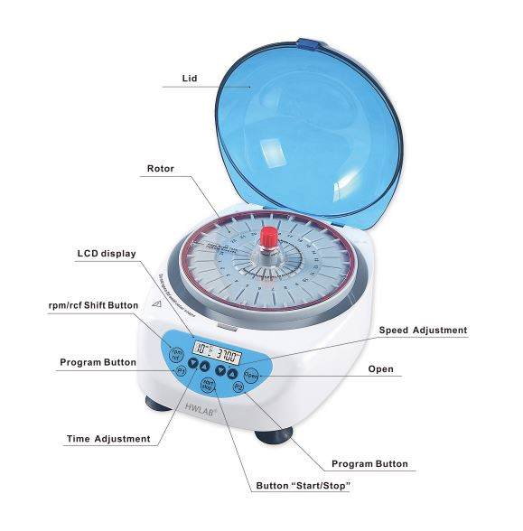
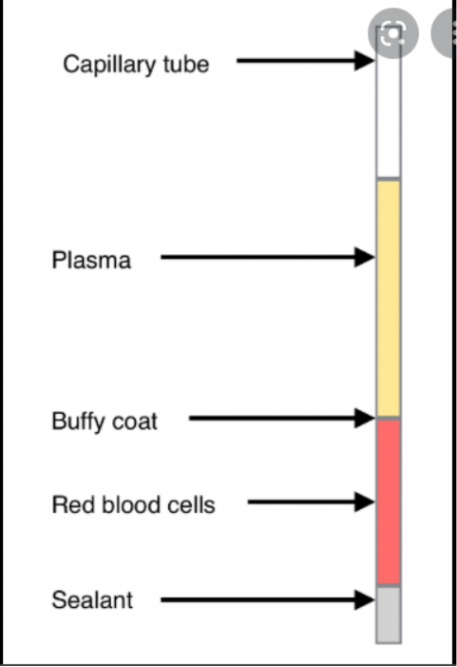
The centrifuge used for the capillary tubes provides a centrifugal force of 12 000 g and 5 min centrifugation results in a constant PCV.

Slide 36
